Slide 1
Identifying Fraud Credit Card Transactions
Nathan Tran
Github:
LinkedIn:

Slide 2
Background
Bank Fraud …effects on the banking industry, customers and the economy!
Damage the image of trust and confidence that banks are expected to portray and exemplify,
Customers lose the money they did not pay for,
Insecure financial environment
Notes:
It is important that credit card companies are able to recognize fraudulent credit card transactions so that customers are not charged for items that they did not purchase.

Slide 3
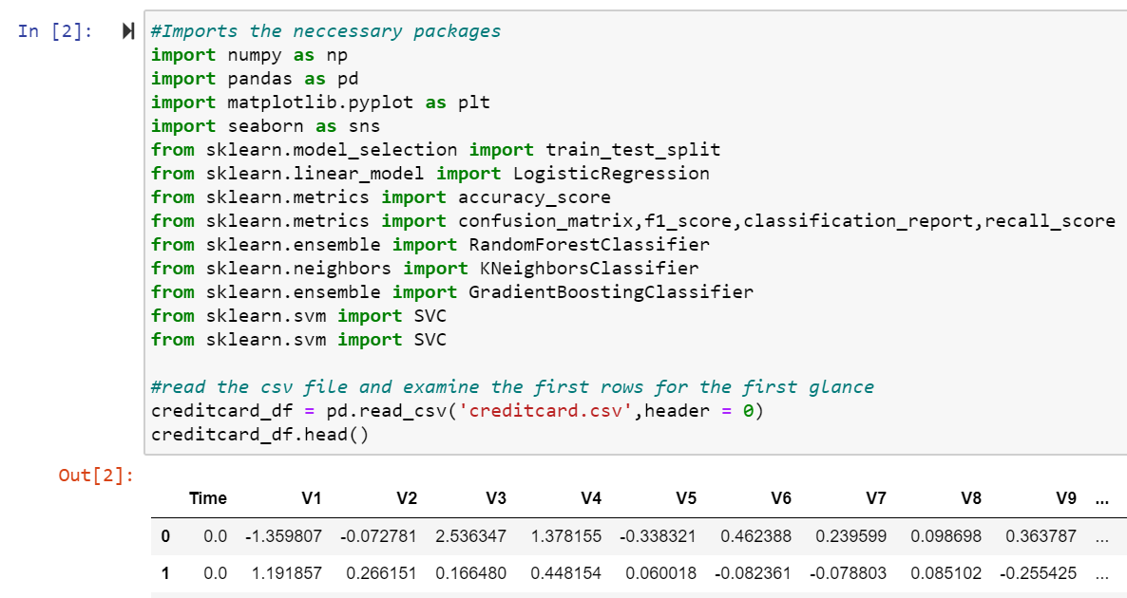
Data/Compute
Source: Kaggle
Details:
Credit card transactions made in two days in September 2013 by European cardholders,
Imbalance dataset: 492 frauds out of 284,807 transactions (0.172% are frauds),
All computational works of this project were done in python and its libraries for data science.
Notes:
The datasets contains transactions made by credit cards in September 2013 by european cardholders.
This dataset presents transactions that occurred in two days, where we have 492 frauds out of 284,807 transactions. The dataset is highly unbalanced, the positive class (frauds) account for 0.172% of all transactions.
All computational works of this project were done in my personal laptop.

Slide 4
Features
The dataset has been transformed by PCA (features V1, V2, …, V28),
Feature 'Time’: the seconds elapsed between each transaction and the first transaction in the dataset,
The feature 'Amount' is the transaction Amount,
Feature 'Class' is the response variable and it takes value 1 in case of fraud and 0 otherwise.
Data quality: Clean with no missing or invalid data values
Train:Test split ratio: 4:1
V1 | V2 | … | V28 | Time | Amount | Class
284,515 Genuine |  |  |  |  |  | (0)
492 Frauds |  |  |  |  |  | (1)
Notes:
The dataset contains only numerical input variables which are the result of a PCA transformation. Unfortunately, due to confidentiality issues, we cannot provide the original features and more background information about the data. Features V1, V2, … V28 are the principal components obtained with PCA, the only features which have not been transformed with PCA are 'Time' and 'Amount'. Feature 'Time' contains the seconds elapsed between each transaction and the first transaction in the dataset. The feature 'Amount' is the transaction Amount. Feature 'Class' is the response variable and it takes value 1 in case of fraud and 0 otherwise.
The dataset from Kaggle is clean. I did not have to put effort for missing or invalid data points
I split the dataset into train-test sets with ratio of 80% and 20%
All computational works of this project were done in my personal laptop.

Slide 5
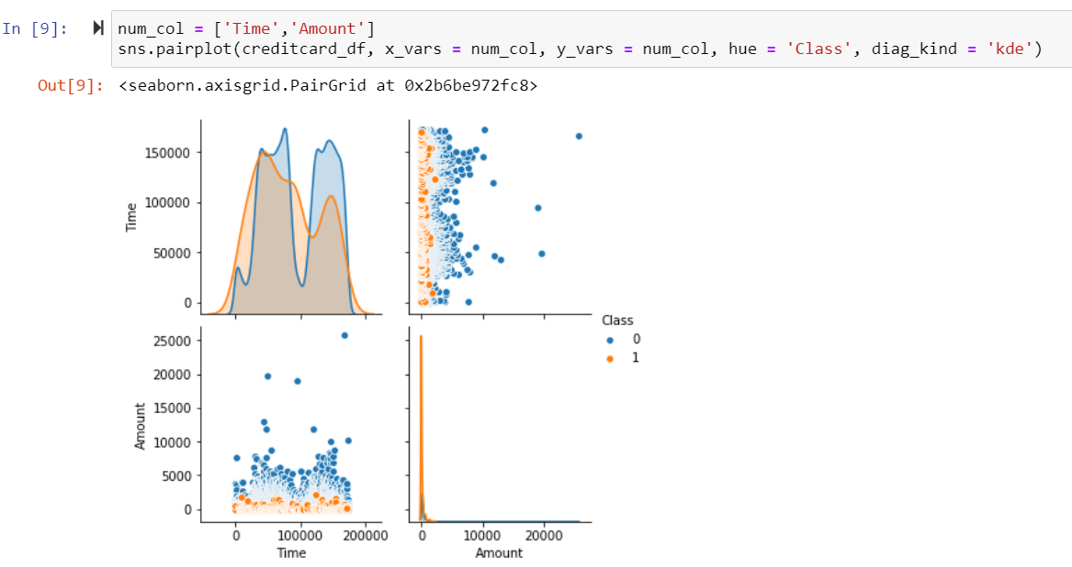
Features ‘Time’ & ‘Amount’
Notes:
The dataset contains only numerical input variables which are the result of a PCA transformation. Unfortunately, due to confidentiality issues, we cannot provide the original features and more background information about the data. Features V1, V2, … V28 are the principal components obtained with PCA, the only features which have not been transformed with PCA are 'Time' and 'Amount'. Feature 'Time' contains the seconds elapsed between each transaction and the first transaction in the dataset. The feature 'Amount' is the transaction Amount. Feature 'Class' is the response variable and it takes value 1 in case of fraud and 0 otherwise.
The dataset from Kaggle is clean. I did not have to put effort for missing or invalid data points
I split the dataset into train-test sets with ratio of 80% and 20%
All computational works of this project were done in my personal laptop.

Slide 6
Metrics for Model Selection
Key metric for model selection: Recall Score
Candidate techniques:
Resampling: None, Oversampling, Undersampling
Models: Logistic Regression, Random Forest, KNN, Gradient Boosting
 | No Resampling | Oversampling | Undersampling
Logistic Regression | The negative class could dominate the accuracy score | Less likely to overfit | Less likely to overfit
 |  | Unstable due to collinearity | Unstable due to collinearity
Random Forest |  | Avoid collinearity | Avoid collinearity
 |  | Can be overfit | Loosing significant information
KNN |  | Avoid collinearity | Avoid collinearity
 |  | Can be overfit | Loosing significant information
Gradient Boosting |  | Avoid multicollinearity | Avoid multicollinearity
 |  | Can be overfit | Can be overfit
Notes:
For detecting fraud, we want to maximize recall score (When there are frauds, how often is the prediction correct)

Slide 7
Modeling without Resampling
 | Logistic Regression |  | Random Forest |  | KNN |  | Gradient Boosting
Accuracy Score | 99.86% |  | 99.57% |  | 99.75% |  | 99.77%
Confusion Matrix | 56,829 | 35 | 56,862 | 2 | 56,824 | 40 | 56860 | 4
 | 43 | 55 | 22 | 76 | 45 | 53 | 21 | 77
The result is much driven by the accuracy on the majority class!
Significant portion of the frauds could not be detected!
Notes:
I ran a quick fit on the candidate models and then made prediction on the testing set
The result is much driven by the accuracy on the majority class!
Significant portion of the frauds could not be detected!

Slide 8
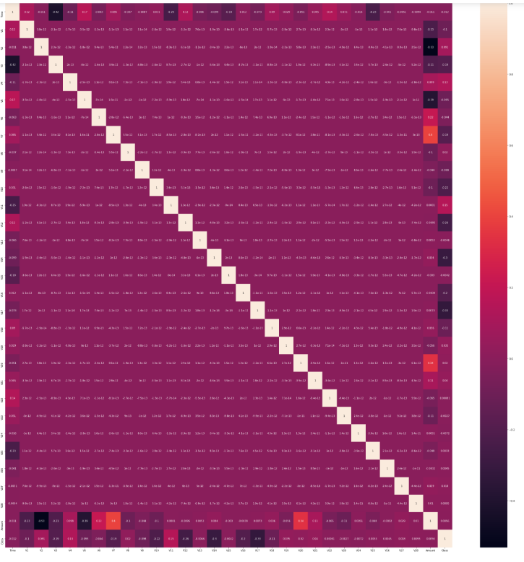
Correlation Matrix
Time
0
Amount
Class
Notes:
As there are some correlation between the non-PCA and PCA variables, it rises my concern about unstable model if I take the logistic regression approach. So for now, my safe approach is either Random Forest or Gradient Boosting and KNN

Slide 9
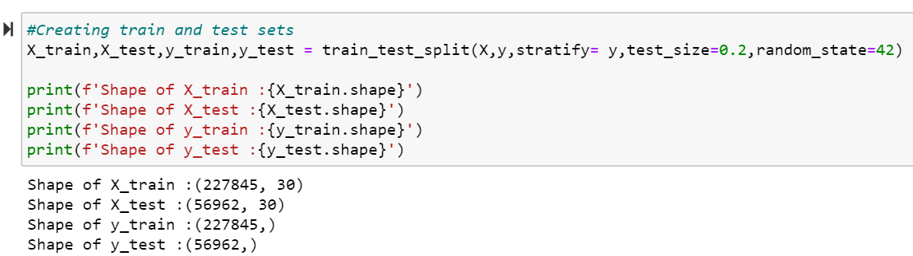
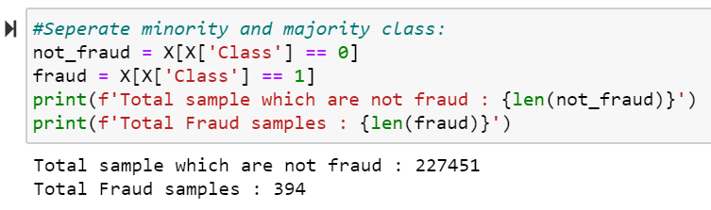
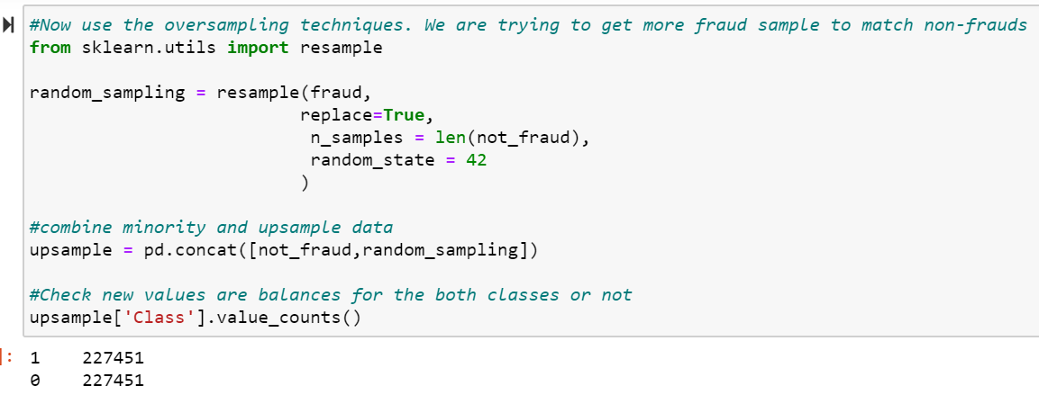
Oversampling
Notes:
Oversampling was my first approach to handle the unbalance in the dataset. For this oversampling attempt, I am upsampling the minority class from 394 samples to over 200 thousands samples. With the significant increase in samples, I worried me about overfitting.

Slide 10




Oversampling
Cross-
-Validation
Testing
Notes:
With the upsampled dataset, I proceeded to validate RF, KNN and GB models. The perfect score from cross validation indicate the over fitting. It is quite true when we applied the overfitted model on the testing set. Recall scare is quite lower than the cross validated model. With that, Oversampling turn out not a good approach to handle this data imbalance.

Slide 11
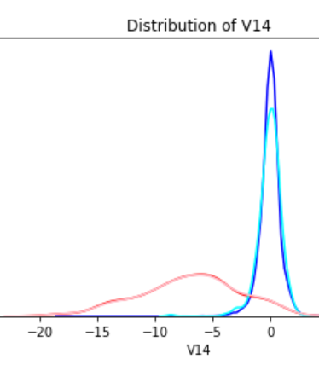
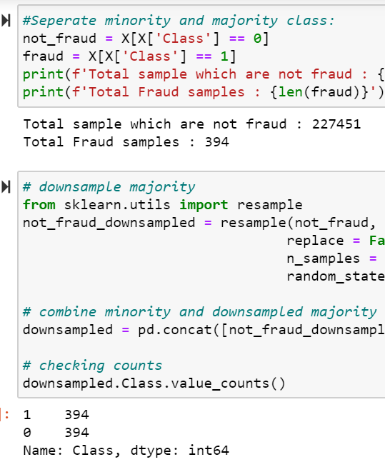
Undersampling
Original Non-Fraud Distribution
Downsampled Non-Fraud Distribution
Original Fraud Distribution
Downsampled Fraud Distribution
Notes:
My next approach to handle that, I tried downsampling. One of the draw back of this method is that information can be lost as we cut off many data points in the majority class. However, if data points are close to each other, downsampling will not affect much and can yield good result. Therefore, after I obtained the down sampled, I made a validation check. I plotted distribution of the original and downsampled variables. If there is not much change in the distribution shape, I assume the downsampled data is effective and can be used for training the algorithmns.

Slide 12


Undersampling Modeling
 | No Resampling | Oversampling | Undersampling
Logistic Regression
Random Forest
KNN
Gradient Boosting

Slide 13
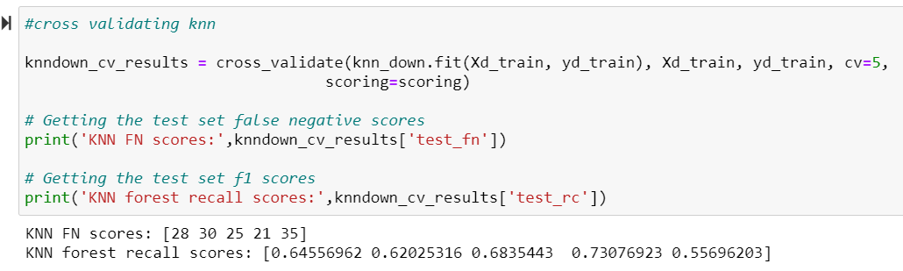
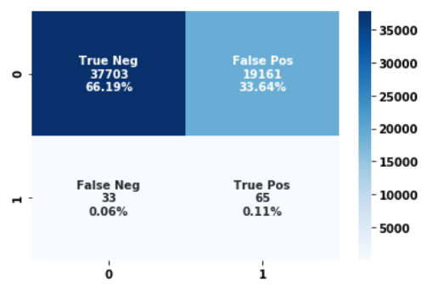
Undersampling Cross-Validation - KNN
Validation:
Testing Base Model:
Notes:
CV RF: 89.8% CV GB:89.6%

Slide 14
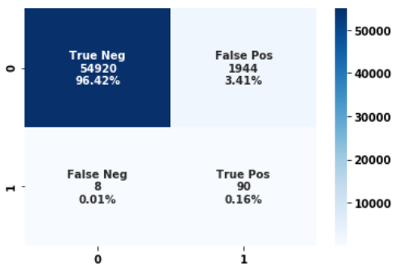
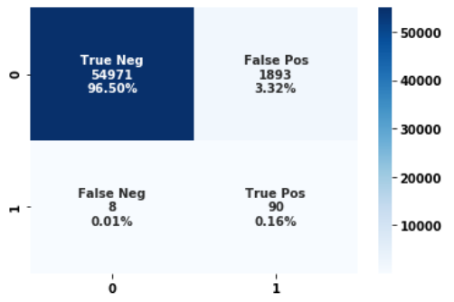
Undersampling Cross-Validation
Validation:
Testing Base Model:
Notes:
CV RF: 89.8% CV GB:89.6%

Slide 15
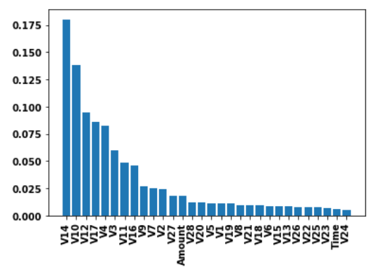
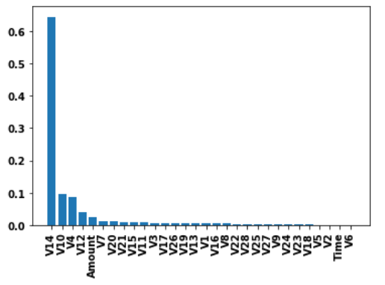
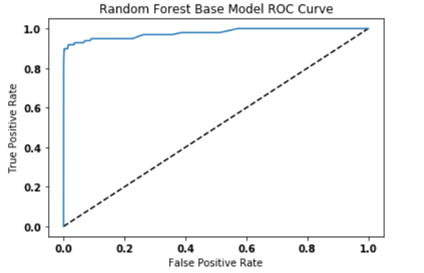
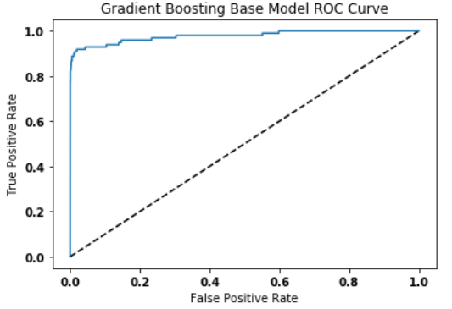
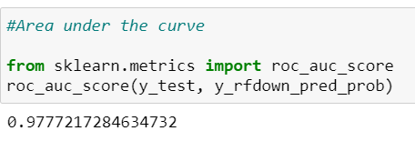
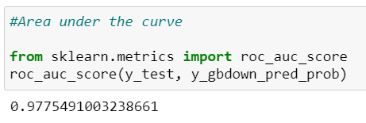
Undersampling Cross-Validation
Features’ Importance: Random Forest Gradient Boosting
ROC:

Slide 16
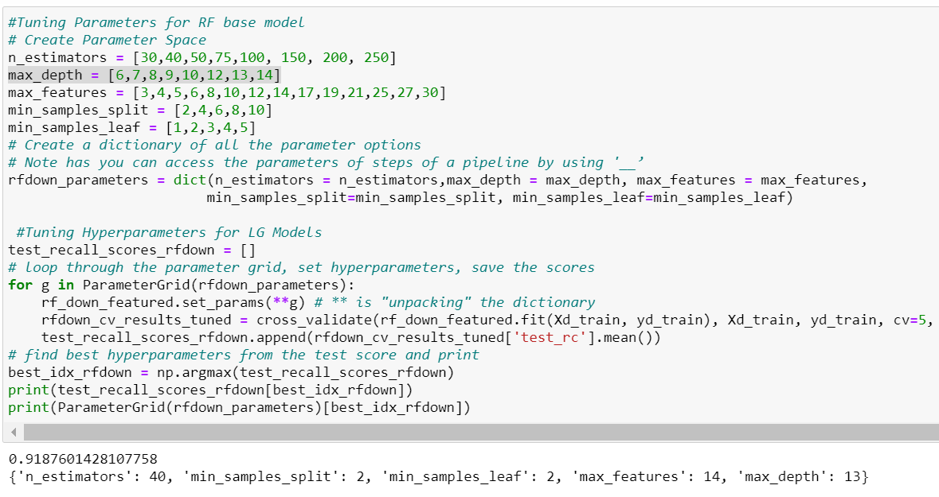
Random Forest Parameter Tuning

Slide 17
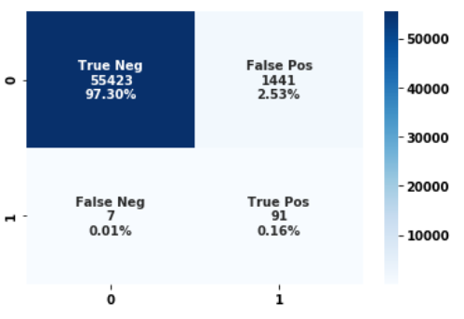
Undersampling – Testing RF Model
Base Model Confusion Matrix
Tuned Model Confusion Matrix

Slide 18
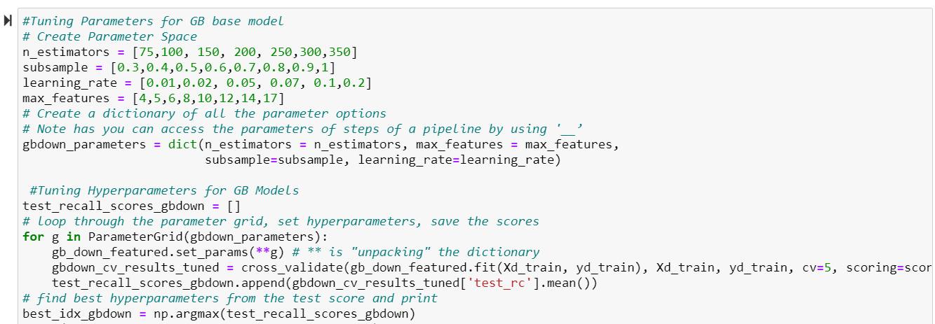
Gradient Boosting Parameter Tuning

Slide 19
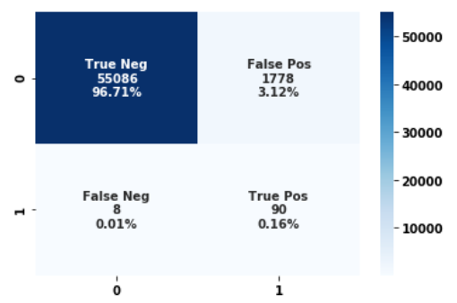
Undersampling – Testing GB Model
Base Model Confusion Matrix
Tuned Model Confusion Matrix

Slide 20
Undersampling – Finalized Model
Tuned RF Model Confusion Matrix
Tuned GB Model Confusion Matrix

Slide 21
Summary
LG
RF
KNN
GB
For this credit card transaction dataset, undersampling has been necessary to avoid overfitting
The success of undersampling is ensured by validating each variable’s distribution before and after such process.
RF and GB models are validated to detect 90/98 frauds transactions from the testing sample. Testing the tuned models shows that it only improved the identification of the genuine transactions.
RF and GB yield very close prediction power. RF perform slightly better than GB in terms of recognizing more genuine transactions.
Undersampling
LG
RF
KNN
GB
EDA
RF
KNN
GB
Training and Tuning
RF

Slide 22
Future Improvement
Research the sensitivity of the model to the size of the training set
Stabilize logistic regression model by orthogonalize the features
Try different resampling techniques (SMOTE, GAN) to oversample the minor class without introducing overfitting. Hopefully, this can improve the fraud detective power
Adjust the predicted probability to get more true positives

Slide 23
Modeling Topic Areas of interest:
· Data size/compute used
· Describe the feature space & how you handled data cleaning/feature selection
· What models did you consider & why did you choose the one you did? What were the strengths/weaknesses of your selected model, and how did you address?
· How did you address potential overfitting? Does overfitting apply to your case at all?
· Model performance – in training, test and validation samples?
· Would have you approached this problem any differently knowing what you do now?
· How did your client(s) leverage your model & insights to drive action/change behavior?

